Slide 2
3-3 State Court Systems
GOALS
Compare the structure of a typical state court system with the structure of the federal courts
Identify typical state courts of specialized jurisdiction

Slide 3
FOCUS
What is the primary difference between the federal court system and a state court system?
The types of specialized courts found:
Federal: Bankruptcy, court of international trade, tax court
State: probate, juvenile, family, small claims

Slide 4
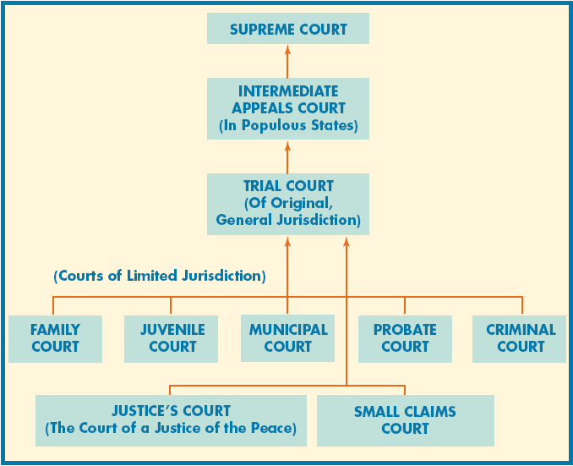
A TYPICAL STATE COURT SYSTEM
3 tier system like the federal system
Geographically based trial courts

Slide 5
A TYPICAL STATE COURT SYSTEM
State trial courts
Courts with general original jurisdiction over both criminal and civil matters are known as circuit courts. (Also known as superior court, district courts or courts of common pleas)
Court of Record – keeps an exact account of what goes on at trial. (transcript, evidence, statements, determinations of the court officials and the judgment of the court)
They review the decisions of courts of specialized jurisdiction.

Slide 6
A TYPICAL STATE COURT SYSTEM
State courts of appeals
No more then 3 judges on panel.
Can hear oral arguments by attorneys, no new evidence.
May apply correct law, send back to lower courts for new trial.
State supreme courts
Typically you are entitled to one trial and one appeal if filed in a timely manner.
Only those with most complex legal issues are taken to supreme court.
Issue the final decision on matters of law appealed to them. If constitutional or other federal questions may appeal to US supreme court.

Slide 7
A TYPICAL STATE COURT SYSTEM

Slide 8
What does a typical state court system have in common with the federal court system?

Slide 9
STATE COURTS WITH SPECIALIZED JURISDICTIONS
Associate circuit courts – also known as county courts
Deal with minor criminal cases, state traffic offenses and lawsuits with small amounts less than $25,000
Not typically court of record
Appeals can go to state trial court
City or municipal courts – administer their ordinances.
Typically divided into traffic and criminal divisions.
Can be appealed to state trial court
Ordinances are not considered criminal lawss.
Small claims courts – handle disputes in which small amounts less than $2,500.
No jury just judge
Can be appealed to state trial court

Slide 10
STATE COURTS WITH SPECIALIZED JURISDICTIONS
Juvenile courts – 13 years old to under 18 years old.
Not held as accountable as adults
Greater emphasis on rehabilitation than punishment.
Can release to supervision of parents, placed in foster homes or detention in correctional facilities
Courtroom is closed during informal hearing
Judgments not open to the public.
If rehabilitation fails can be tried and punished as an adult.
Appeals to are directed to circuit courts
Probate court – courts that administer wills and estates

Slide 11
Name the typical state courts that have specialized jurisdiction.

